Slide 1
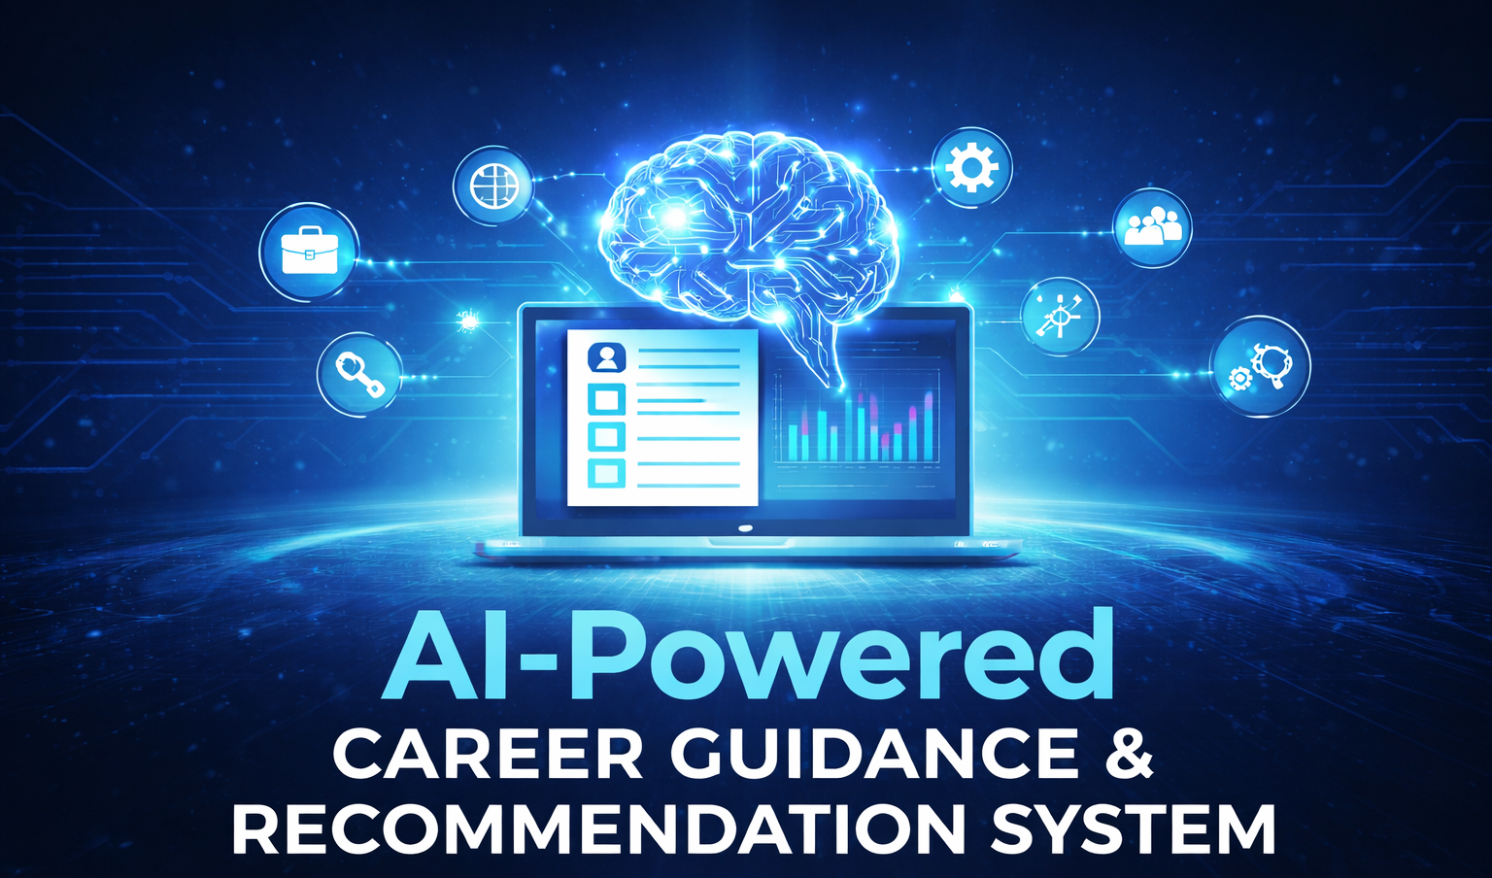
AI-Powered Career Guidance & Recommendation System
Team:B8
B.Bindu Sri(Y22ACS422)
K.Sanjay Krishna(Y22ACS469)
B.Tharshi(Y22ACS427)
G.Sivamani(Y22ACS456)
Under the Guidance of
Dr.P.S.V.Vachaspati
Professor,CSE

Slide 2
INTRODUCTION
In the modern educational landscape, students face significant challenges in choosing the right career path due to a lack of personalized guidance and clarity about industry requirements. Many students are unsure about their strengths, skills, and the opportunities available to them. Traditional career counseling methods are often generic and fail to provide data-driven insights.
The AI-Powered Career Guidance & Recommendation System is designed to assist students in making informed career decisions by analyzing their resumes and skill profiles. By leveraging Artificial Intelligence (AI) and Natural Language Processing (NLP), the system provides personalized career recommendations, identifies skill gaps, and offers structured learning guidance to help students achieve their career goals.

Slide 3
PROBLEM STATEMENT
In today’s highly competitive and rapidly evolving job market, students often face significant challenges in choosing the right career path due to a lack of personalized guidance and clear understanding of industry requirements. Many students are unsure about their strengths, skills, and interests, which leads to confusion and poor decision-making.
Traditional career counseling methods are often generic, time-consuming, and not easily accessible to all students. Additionally, existing job portals primarily focus on job listings and applications rather than helping individuals plan their careers or develop the necessary skills. They do not provide in-depth analysis of a student’s profile or identify skill gaps required for specific roles. As a result, students may pursue unsuitable career paths or remain underprepared for industry demands.

Slide 4
OBJECTIVES
Analyze student profiles using AI & NLP
Extract skills, education, and experience from resumes
Provide personalized career recommendations
Explain recommendations (Explainable AI)
Identify skill gaps for each career path
Suggest structured learning guidance
Track progress and career readiness
Generate detailed career reports
Ensure user-friendly interface
Support informed career decision-making

Slide 5
EXISTING SYSTEM
The existing systems available for career guidance mainly include job portals, career websites, and traditional counseling methods. These platforms primarily focus on providing job listings and application services rather than guiding students in choosing the right career path.
Most job portals offer limited personalization and do not analyze individual student profiles in depth.
They lack advanced features such as resume-based skill extraction, career suitability analysis, and identification of skill gaps.
Traditional career counseling, on the other hand, is often time-consuming, expensive, and not easily accessible to all students. Additionally, these methods rely heavily on manual guidance and may not always reflect current industry trends. As a result, students receive generic advice that does not align with their unique skills, interests, or career goals, making existing systems less effective for comprehensive career planning and development.

Slide 6
PROPSED SYSTEM
Upload resume and analyze using AI & NLP techniques
Extract key details like skills, education, and experience
Provide personalized career recommendations based on profile
Give clear explanations for each recommended career path
Identify missing or weak skills required for selected roles
Suggest structured learning guidance for skill improvement
Redirect users to external platforms for learning resources
Track progress using career readiness scores and charts
Generate detailed career report in PDF format
Provide simple, user-friendly, and interactive interface

Slide 7
SYSTEM ARCHITECTURE
The AI-Powered Career Guidance & Recommendation System follows a client-server architecture that ensures efficient data processing, scalability, and smooth user interaction.
The system is divided into four main components: Frontend, Backend, Database, and AI/NLP Module.
The Frontend acts as the user interface where students can register, log in, upload their resumes, and view career recommendations, skill gaps, and reports. It is designed to be interactive and user-friendly.
The Backend handles all the core processing of the system. It receives user inputs, processes resume data, communicates with the AI module, and generates results such as career suggestions and reports.
The AI/NLP Module is the key component of the system. It analyzes the uploaded resume using Natural Language Processing techniques to extract important information like skills, education, and experience. Based on this data, it recommends suitable career paths and identifies skill gaps.
The Database stores all user-related data, including profiles, resumes, extracted skills, career recommendations, and progress tracking information.

Slide 8
DESIGN METHODOLOGY
The AI-Powered Career Guidance & Recommendation System is developed using a structured approach to ensure reliability, scalability, and efficiency. The process includes the following steps:
Requirement Analysis: Identify user needs such as resume analysis, career recommendations, and skill gap detection, along with defining system requirements.
System Design: Plan the overall architecture, including frontend, backend, database, and AI modules, along with data flow and interface design.
Implementation: Develop the system using suitable technologies, integrating frontend, backend, and AI/NLP components.
Testing: Verify system accuracy, performance, and functionality through various test cases.
Maintenance and Enhancement: Continuously update the system to fix issues and improve features based on user feedback.

Slide 9
TECHNOLOGIES USED
The AI-Powered Career Guidance & Recommendation System is developed using modern technologies to ensure efficiency and scalability:
Frontend Technologies: HTML, CSS, JavaScript, and React.js are used to design an interactive and user-friendly interface.
Backend Technologies: Python or Node.js is used to handle server-side logic, data processing, and system operations.
Database: MongoDB or MySQL is used to store user data, resumes, and career-related information.
AI/NLP Tools: Libraries like NLTK and spaCy are used for resume parsing, skill extraction, and analysis.
Visualization Tools: Chart.js or similar libraries are used to display progress and performance through charts.

Slide 10
FRONTEND&BACKEND
Frontend:
In this project, the frontend provides interfaces for user registration, login, and resume upload. It displays extracted skills, recommended career roles with explanations, identified skill gaps, progress charts, and downloadable career reports in a clear and user-friendly manner.
Backend:
The backend processes the uploaded resumes using AI and NLP techniques to extract relevant information such as skills, education, and experience. It generates personalized career recommendations, identifies missing skills, provides learning guidance, manages user data, and handles report generation.

Slide 11
SOFTWARE
Software Requirements:
Operating System: Windows / Linux / macOS
Frontend Technologies: HTML, CSS, JavaScript, React.js
Backend Technologies: Python or Node.js
Database: MongoDB / MySQL
AI/NLP Libraries: NLTK, spaCy
Development Tools: VS Code / PyCharm
Web Browser: Google Chrome / Edge
Version Control: Git (optional)

Slide 12
HARDWARE
Hardware Requirements:
Processor: Intel i3 or above
RAM: Minimum 4 GB (8 GB recommended)
Storage: At least 10 GB free space
System Type: 64-bit computer/laptop
Internet Connection: Required for system usage and updates

Slide 13
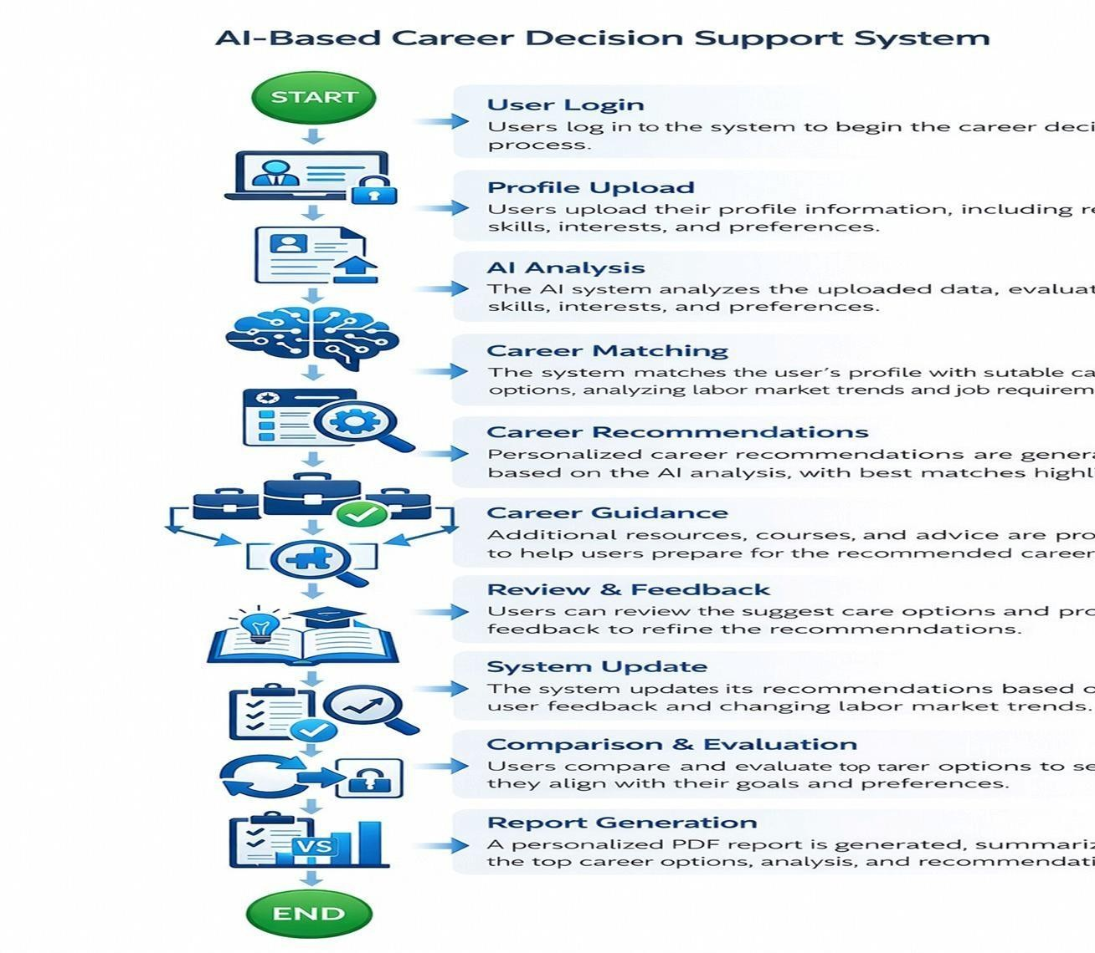
FLOW CHART

Slide 14
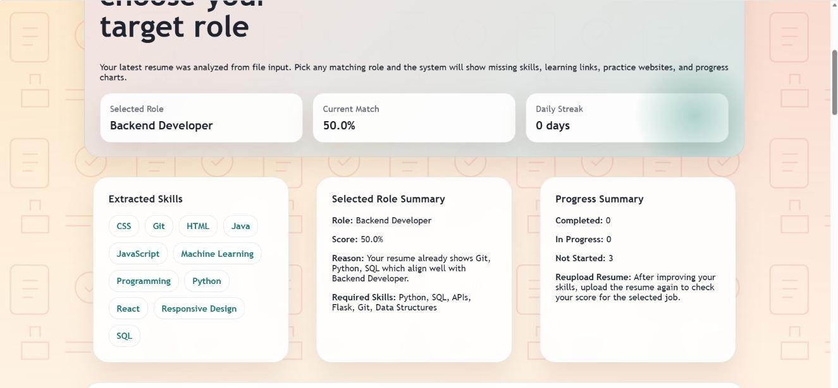
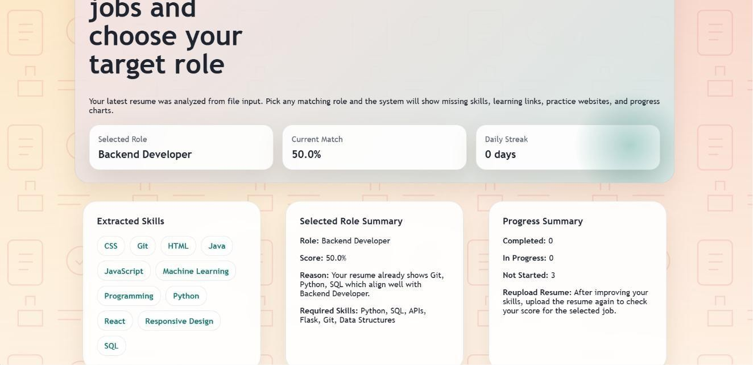
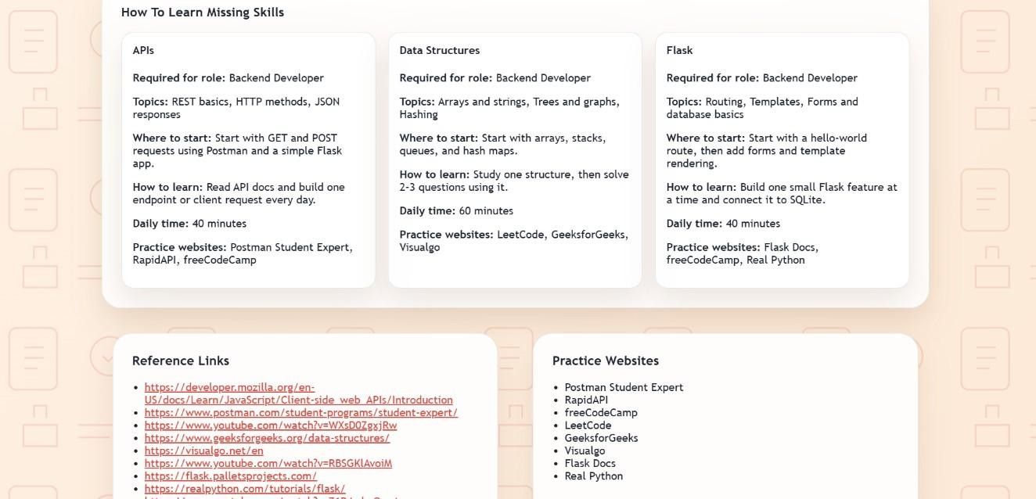
OUTPUT SCREENS

Slide 15
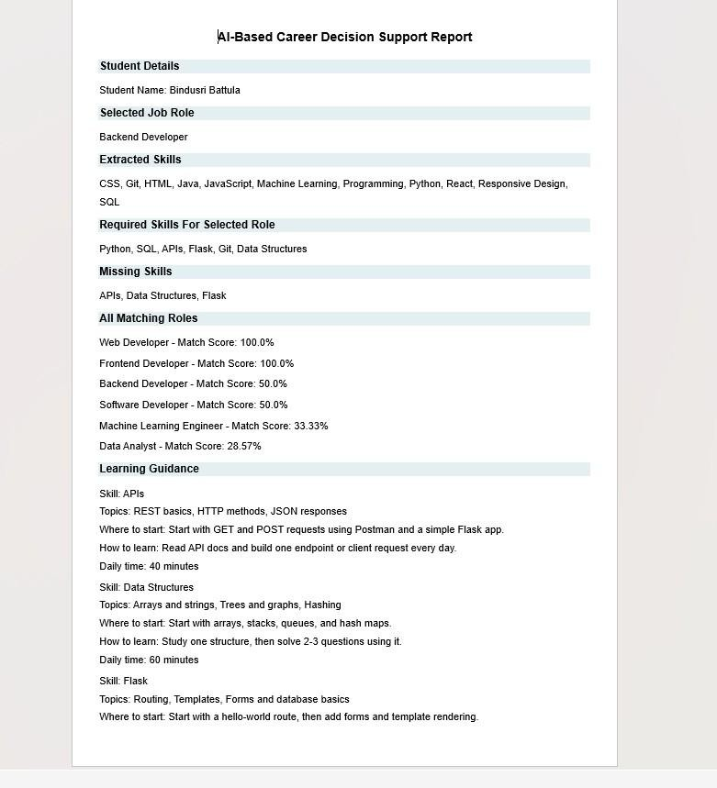
OUTPUT SCREEN

Slide 16
ADVANTAGES
Provides personalized career recommendations
Uses AI & NLP for accurate analysis
Offers explainable results for better understanding
Identifies skill gaps effectively
Suggests structured learning guidance
Generates detailed career reports
Saves time compared to traditional counseling
User-friendly and easy to use
Supports better career decision-making

Slide 17
LIMITATIONS
Depends on the quality and accuracy of the uploaded resume
Limited to predefined career roles and datasets
AI recommendations may not always be 100% accurate
Requires stable internet connection
Cannot fully replace human career counseling
Limited understanding of soft skills and personal interests
Performance depends on the training data used
Initial setup and data collection required

Slide 18
FUTURE SCOPE
Integration with real-time job market data for updated recommendations
Development of a mobile application for easy accessibility
Integration with online learning platforms APIs
Multi-language support for wider user reach
Continuous system improvement based on user feedback

Slide 19
CONCLUSION
The AI-Powered Career Guidance & Recommendation System provides an effective and intelligent solution for helping students make informed career decisions. By leveraging AI and NLP techniques, the system analyzes user profiles, recommends suitable career paths, and identifies skill gaps. It also offers structured learning guidance and tracks progress, enabling students to improve their career readiness over time.
Overall, the system simplifies the career planning process, reduces confusion, and empowers students to choose the right path based on their strengths and abilities. It serves as a valuable tool for enhancing employability and supporting modern education systems.

Slide 20


